Slide 1
SKYTRAX AIRLINE REVIEW ANALYSIS
Presented by Joel Tamakloe
Dated: 10/05/2025

Slide 2
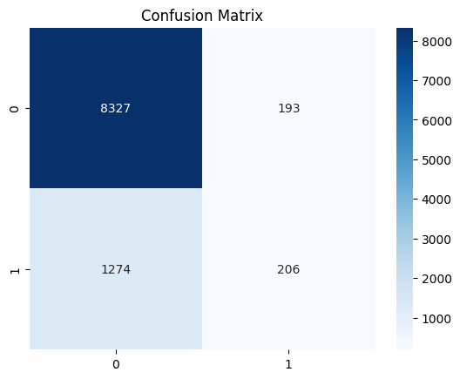
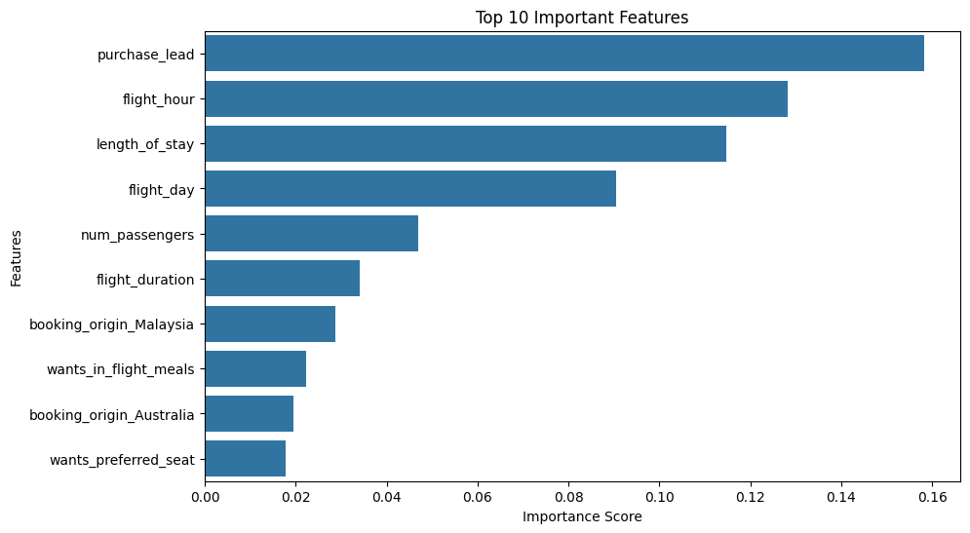
Results
The frequency chart shows the relationship between features influencing flight bookings
Features like purchase_lead,flight_hour,length of stay show degress of correlation with the target
Out of a 50,000 bookings, 7478 (15%)were completed bookings. This means that majority of customers did not complete their bookings.

Slide 3
Classification Report
Class (Booking) | Precision | Recall | F1-Score | Support
0 (No Booking) | 0.87 | 0.98 | 0.92 | 8,520
1 (Booking) | 0.52 | 0.14 | 0.22 | 1,480
Accuracy |  |  | 0.85 | 10,000
Macro Avg | 0.69 | 0.56 | 0.57 | 10,000
Weighted Avg | 0.82 | 0.85 | 0.82 | 10,000
The overall Accuracy is 85% with the model performing well with incomplete booking. Cross-validation confirms the model’s stability across different subsets of data
Complete bookings struggles with prediction due to imbalance having only 15% .

